Slide 1

S
IT securityDesign
www.easybusy.am

Slide 2

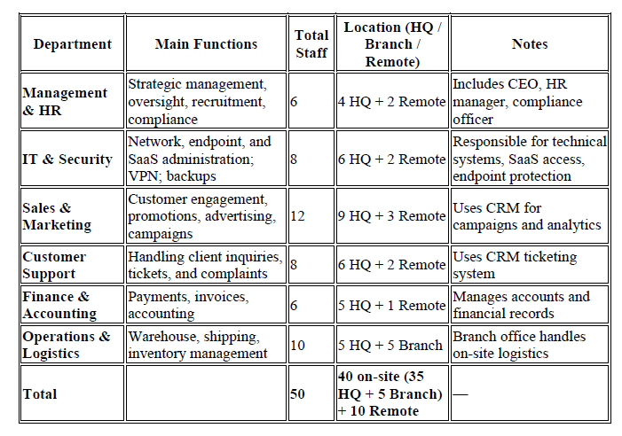

About Company
EasyBusy is a mid-sized e-commerce company with 50 employees, operating from a headquarters, one branch office, and with 20% remote staff. The company sells household goods online. It uses a cloud-first model — all key services are SaaS-based (email, CRM, accounting, and e-commerce platform).

Slide 3

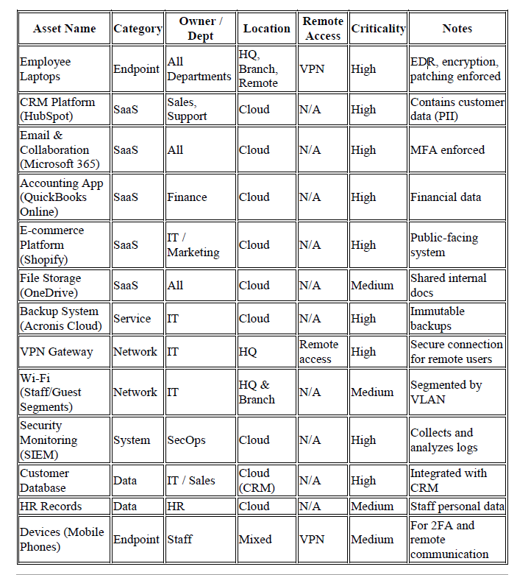

ASSET INVENTORY

Slide 4


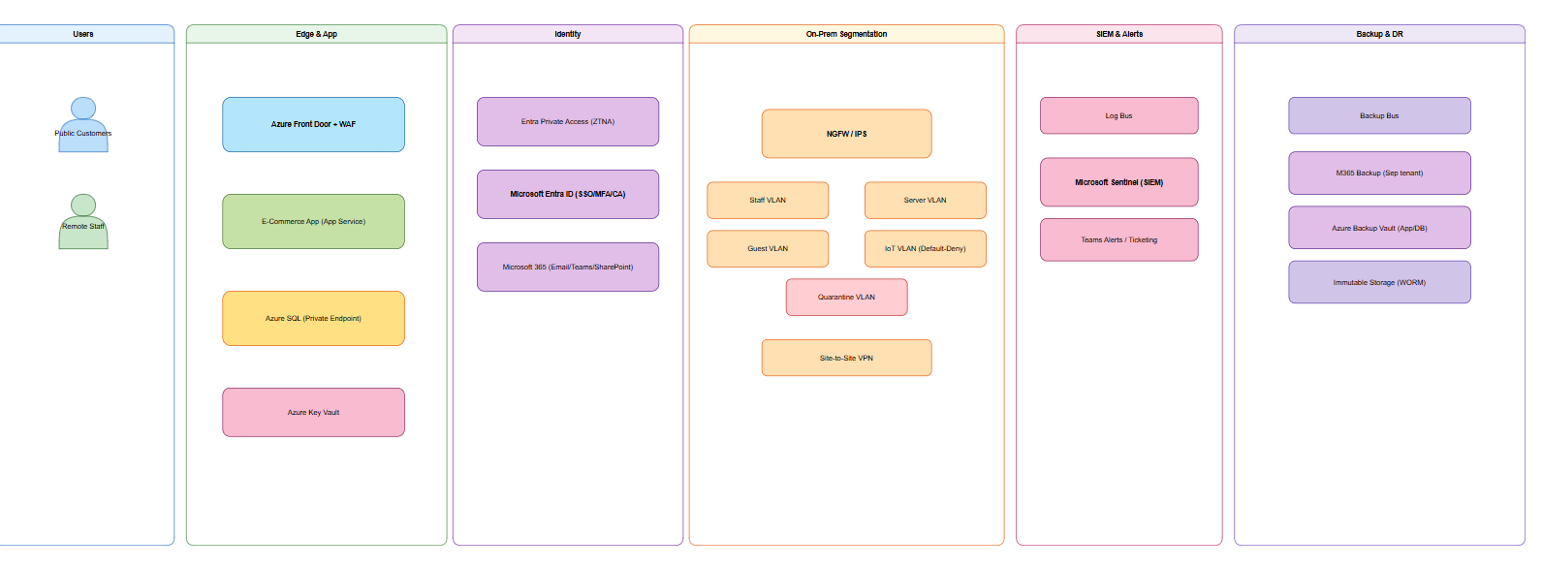
ARCHITECTURE
Studio Shodwe

Slide 5

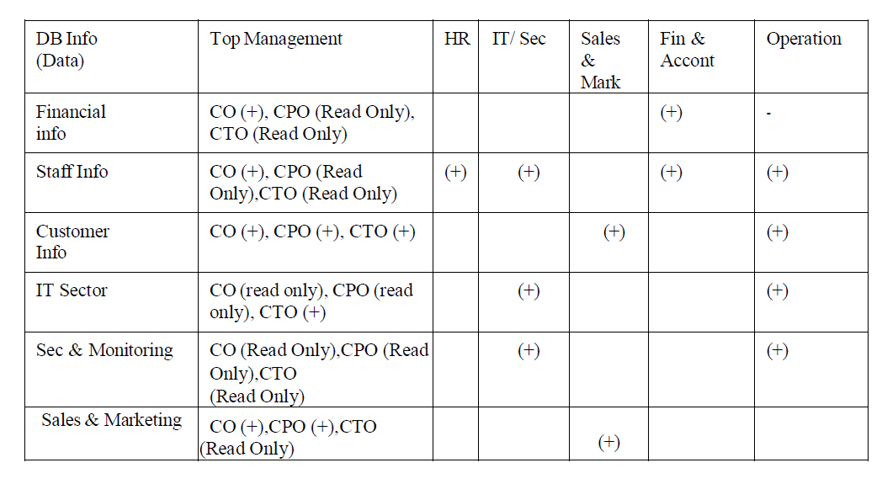
NETWORK SeGMENTATION
All Team leads can open ticket to Operation team and ask Temporary DB access
1. Just-in-Time (JIT) access: This is a security model where users are granted privileged access to a database only when they request it and for a limited duration.
2. Temporary tables: This refers to creating tables that only exist for the duration of a user's current database session.

Slide 6
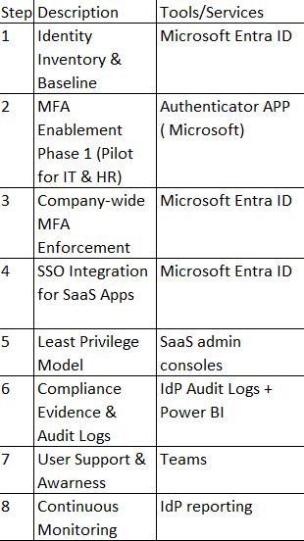



Identity & Saas

Slide 7

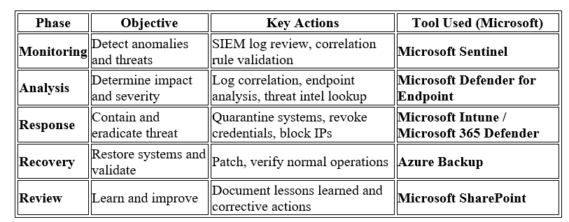


SOC Workflow Overview

Slide 8

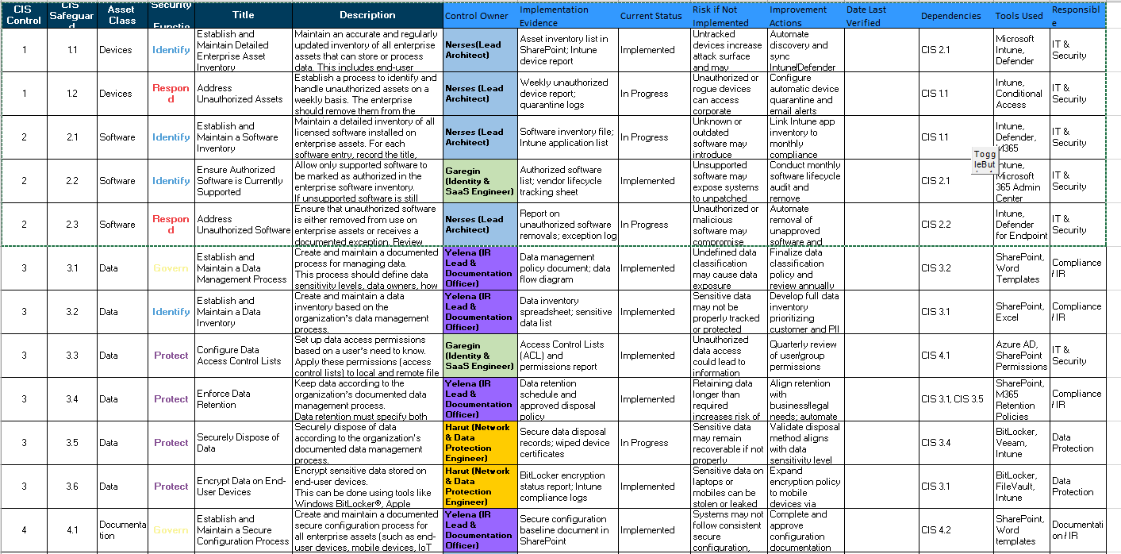
CIS CONTROLS

Slide 9
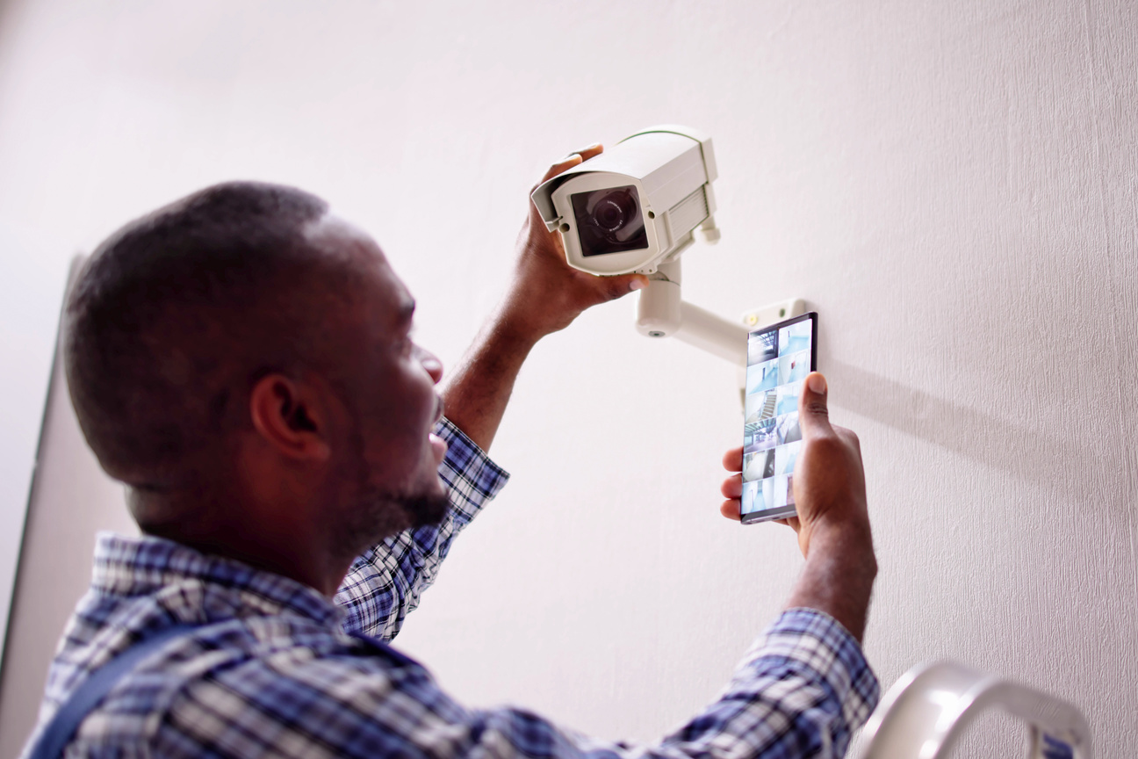
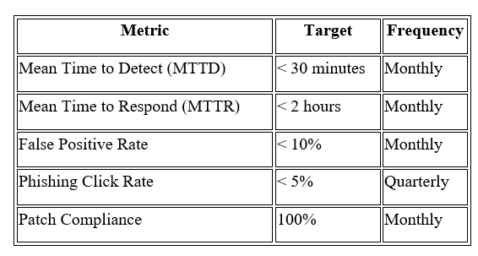
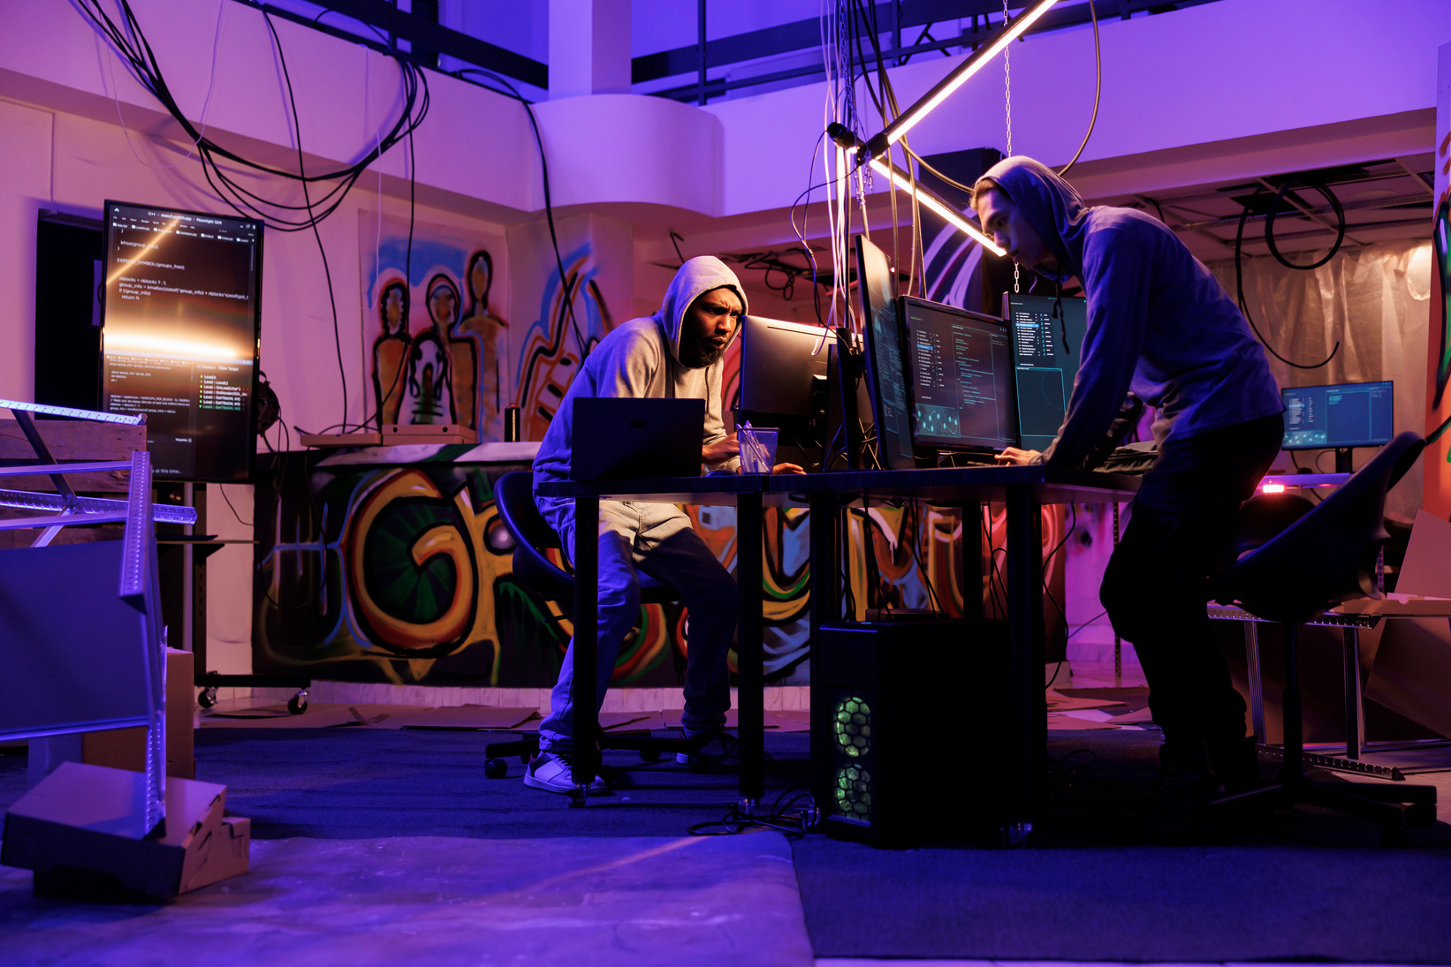
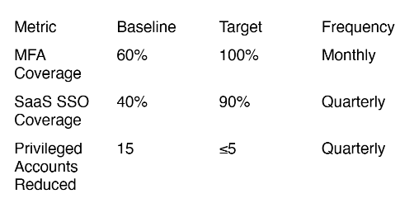
KPI/METRICS

Slide 10
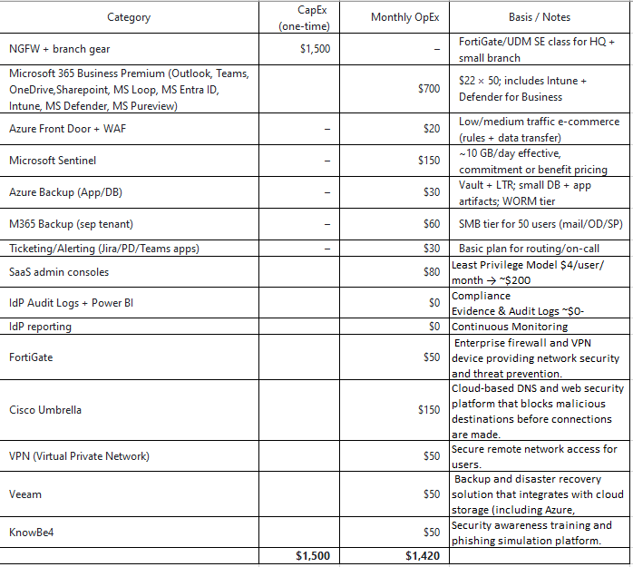
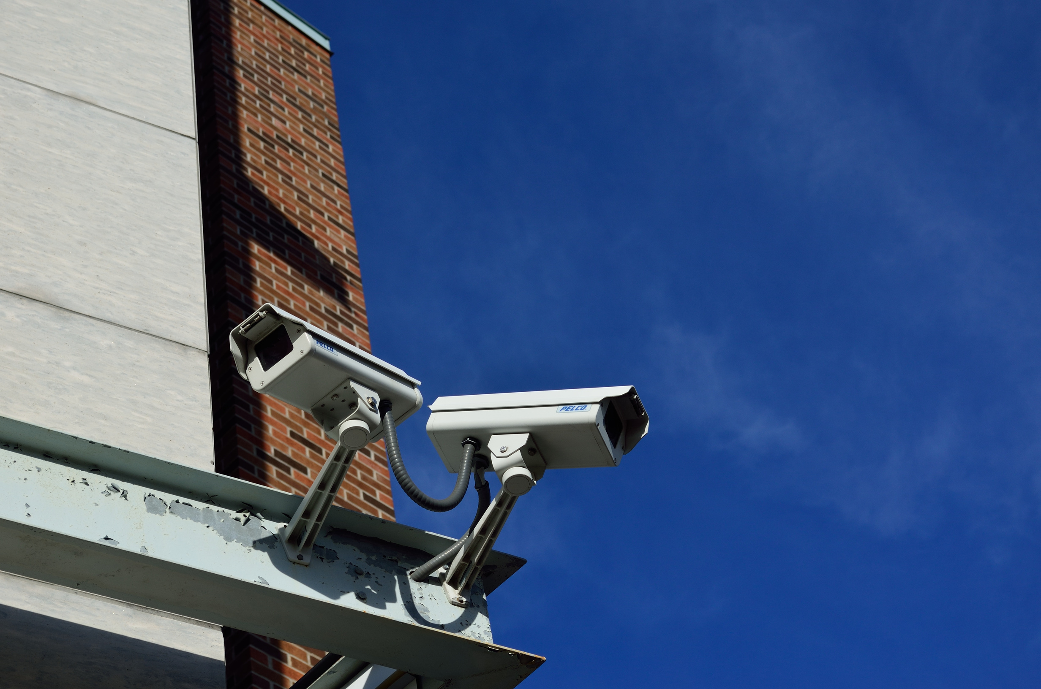
BUDGET

Slide 11
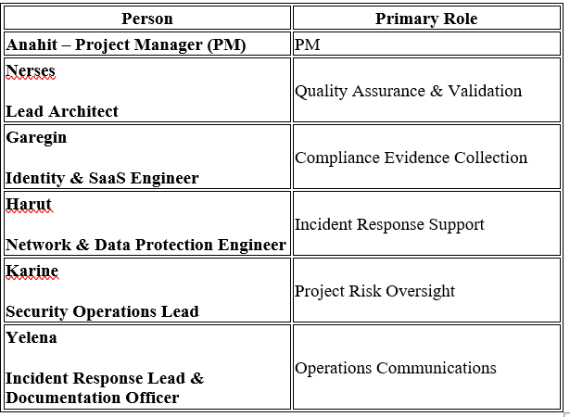
Thank you
Team Members

